Slide 1
COMP-SCI 5542 (SP17) - Big Data Analytics and Applications
Presentation of Paper 6
VQA: Visual Question Answering
Stanislaw Antol, et al.
(Proceedings of the IEEE International Conference on Computer Vision, 2015)
Mar 21st, 2017
Team 9: | Chen Wang (44) - First Speaker (2-8)
 | Yunlong Liu (22) - (10-17)
 | Dayu Wang (45) - (19-23)

Slide 2
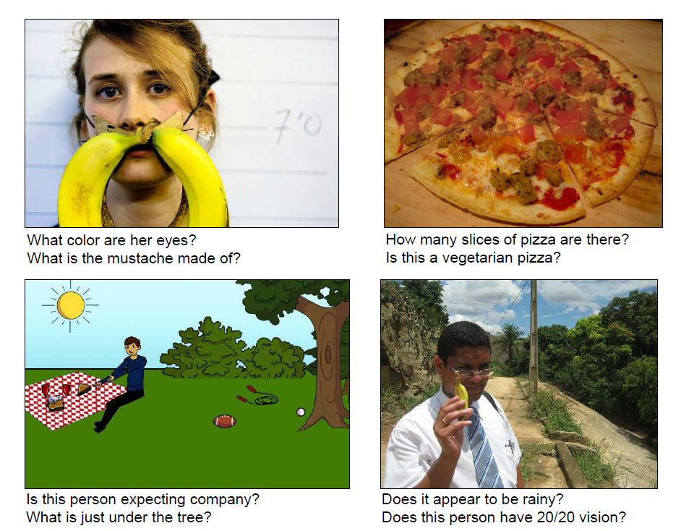
Introduction
VQA:
Visual Question Answering
Ref: Antol, Stanislaw, et al. "Vqa: Visual question answering." Proceedings of the IEEE International Conference on Computer Vision. 2015.

Slide 3
Introduction
AI-complete Task:
Ideal task should
(i) require multi-modal knowledge beyond a single sub-domain
(ii) have a well-defined quantitative evaluation metric to track progress.
AI-complete Task
Multi-modal knowledge
Quantitative Evaluation Metric

Slide 4
Introduction
Fine-grained recognition
What kind of cheese is on the pizza?
Answers of
Free-form and
open-ended VQA
Object detection
How many bikes are there?
Activity recognition
Is this man crying?
Knowledge base reasoning
Is this a vegetarian pizza?
Commonsense reasoning
Is this person expecting company?

Slide 5
Related Work
Related Work | VQA Efforts | Text-based Q&A | Describing Visual Content | Other Vision+Language Tasks.
Use | Study visual question answering | Well studied problem in the NLP and text processing communities | Words or sentences are generated to describe visual content | Intersection of vision and language
Limited | fairly restricted settings with small datasets. | Text is the grounding of questions | Captions can often be non-specific | Limited set of visual concepts tend to be captured
Innovation | Involves open- ended, free-form questions and answers provided by humans | VQA requires the understanding of both text vision | VQA require detailed specific information about the image | Richer variety of visual concepts emerge from visual questions and their answers

Slide 6
VQA Dataset Collection
Real Images
Abstract Scenes
Splits
VQA Datasets
Captions
Questions
Answers

Slide 7
VQA Dataset Collection
Microsoft Common Objects in Context datasets which containing multiple objects and rich contextual information.
Real Images
Abstract Scenes
A new abstract scenes dataset containing 50K scenes based on high-level tasks.
Splits
The same train/val/test split strategy as the MC COCO dataset.

Slide 8
VQA Dataset Collection
Captions
The datasets contains five single-sentence captions for all images.
Questions
Three questions from unique workers were gathered for each image/scene.
Answers
Gather 10 answers for each question from unique workers, while

Slide 9
Questions?
The next speaker is Yunlong Liu (22).

Slide 10
VQA Dataset Analysis
questions
VQA Dataset Analysis
answers
commonsense knowledge

Slide 11
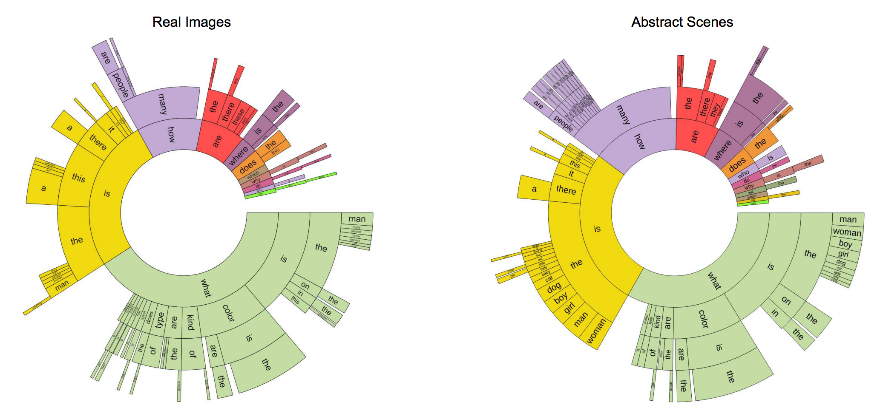
questions analysis
Types of Questions
based on the words that start the question

Slide 12
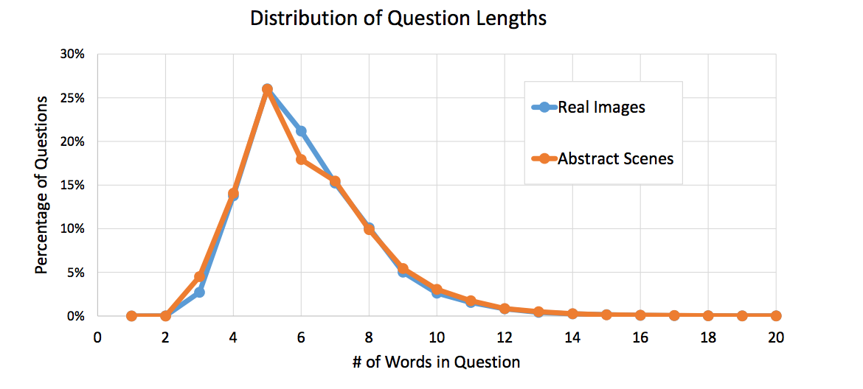
questions analysis
Lengths of Questions

Slide 13
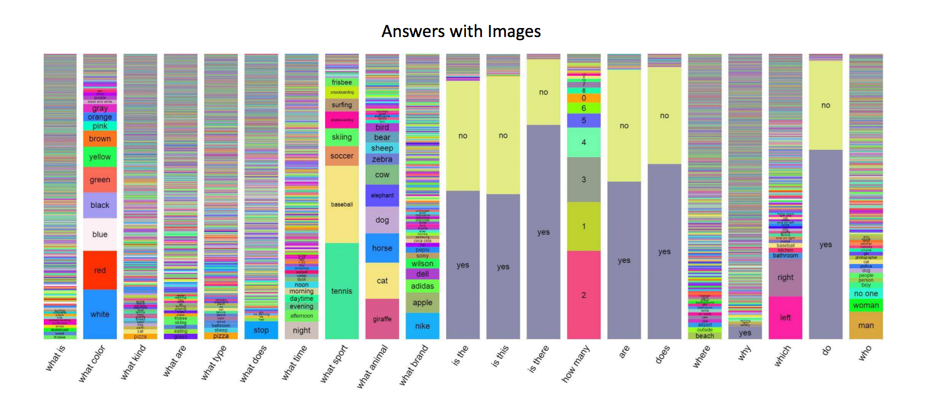
Answers analysis
typical Answers
typical answers using “yes” and “no”
rich diversity of responses
specialized responses

Slide 14
Answers analysis
Lengths
 | one word | two words | three words
real images | 89.32% | 6.91% | 2.74%
abstract scenes | 90.51% | 5.89% | 2.49%
percentage of the lengths
‘Yes/No’ and ‘Number’ Answers
Many questions are answered using either “yes” or “no” (or sometimes “maybe”)
– 38.37% and 40.66% of the questions on real images and abstract scenes respectively. Among these ‘yes/no’ questions, there is a bias towards “yes” – 58.83% and 55.86% of ‘yes/no’ answers are “yes” for real images and abstract scenes.

Slide 15
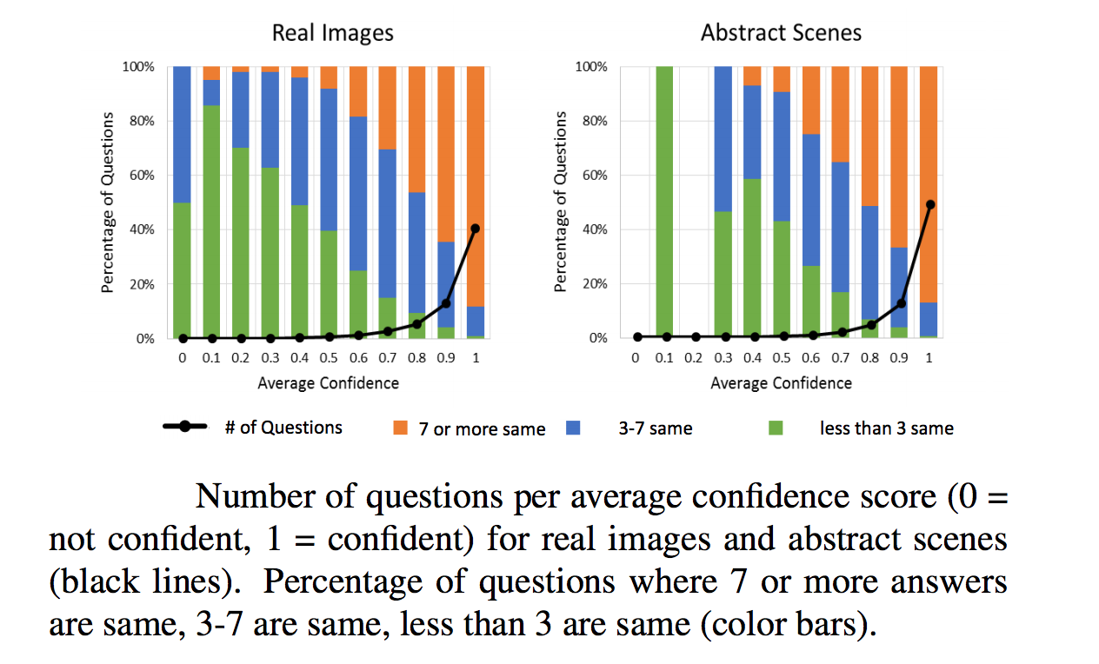
Answers analysis
Subject Confidence
When the subjects answered the questions, we asked “Do you think you were able to answer the
question correctly?”
Inter-human Agreement
the agreement between subjects increases with confidence.

Slide 16
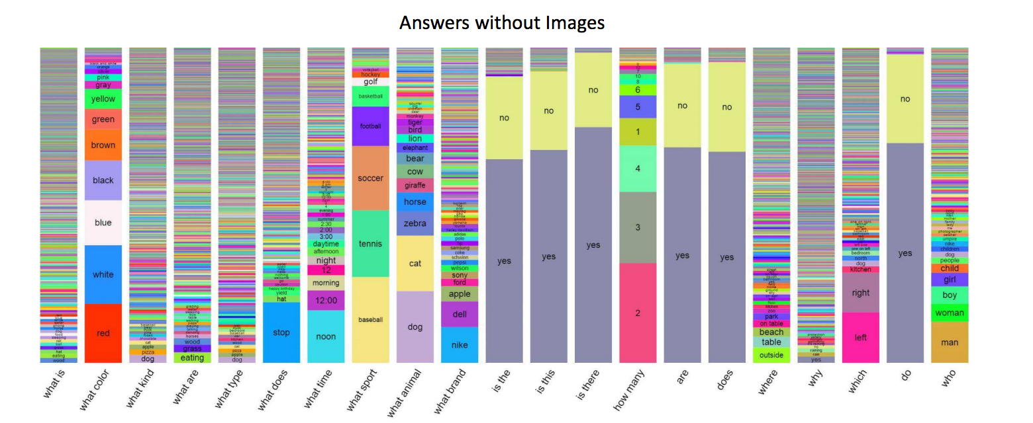
Commonsense Knowledge
1. answers without images
some questions can sometimes be answered correctly using commonsense knowledge alone without the need for an image.

Slide 17
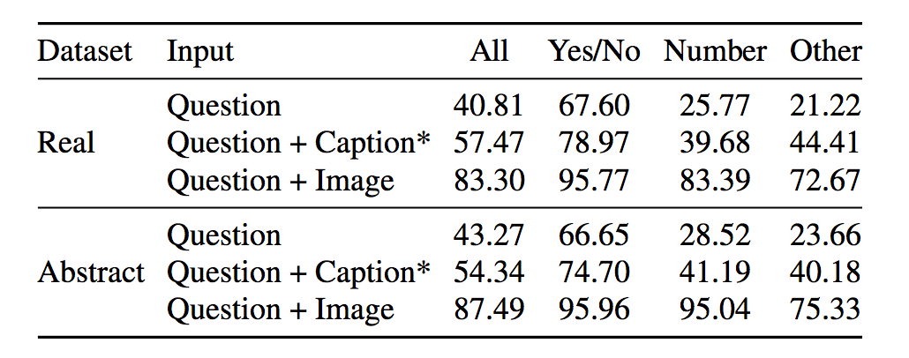
Commonsense Knowledge
the percentage of questions answered correctly when human
subjects are given the question and a human-provided caption
describing the image, but not the image.

Slide 18
Questions?
The next speaker is Dayu Wang (45).

Slide 19
Dayu Wang (45) - VQA Baselines and Methods - Preliminary Results
·VQA Baselines and Methods (Part 5)
·Preliminary Results - Microsoft COCO Dataset
Accuracy
Randomly Choose from Top 1K Answers
0.12%
Choose the Most Popular Answer
29.72%
Choose the Most Popular Answer per Question Type
36.18%
Nearest Neighbor Approach
40.61%
k nearest (question, image) pairs  based on the test question
Spark Word2Vec used to get neighbors  cosine similarity
Pick m (1 ≤ m ≤ k) answers which have “consensus” answers.
Devlin, J., et al. (2015). Exploring nearest neighbor approaches for image captioning. arXiv preprint arXiv:1505.04467.
Lin, T. Y., et al. (2014). Microsoft COCO: Common Objects in Context. Euro Conf Computer Vision (740-755). Springer.
Mohapatra, A. (2015). Exploring Nearest Neighbor Approach on VQA. ECE 5554 (FS15) Class Project. Virginia Tech.

Slide 20
Dayu Wang (45) - VQA Baselines and Methods - Training Baselines
·Training Baselines - k = 1000  covers 82.67% of (train, val) answers.
MLP Neural Network Classifier
LSTM Model + Softmax Layer
hiddenLayers := 2
hiddenUnits := 1000
dropout := 0.5
(with tanh non-linearity)
One-Hot Encoding
Linear Transformation
Question | Caption | Image
Bag-of-Words (1000) | Human-Generated Inputs | Last Hidden Layer of VGGNet (4096-Dimensional Feature)
30-Dimentional Rep. (first, second, third) × 10 | Bag-of-Words Rep. (1000 Words in Caption) | Q + I, Q + C, Q + I + C (FHL Rep Trained on Features Ind)
1030-Dimentional Input (Concatenated) | VGG = Visual Geometry Group (Univ. of Oxford) Very Deep Convolutional Networks for Large-Scale Visual Recognition
Simonyan, K., et al. (2014). Very Deep Convolutional Networks for Large-Scale Image Recognition. arXiv preprint arXiv.

Slide 21
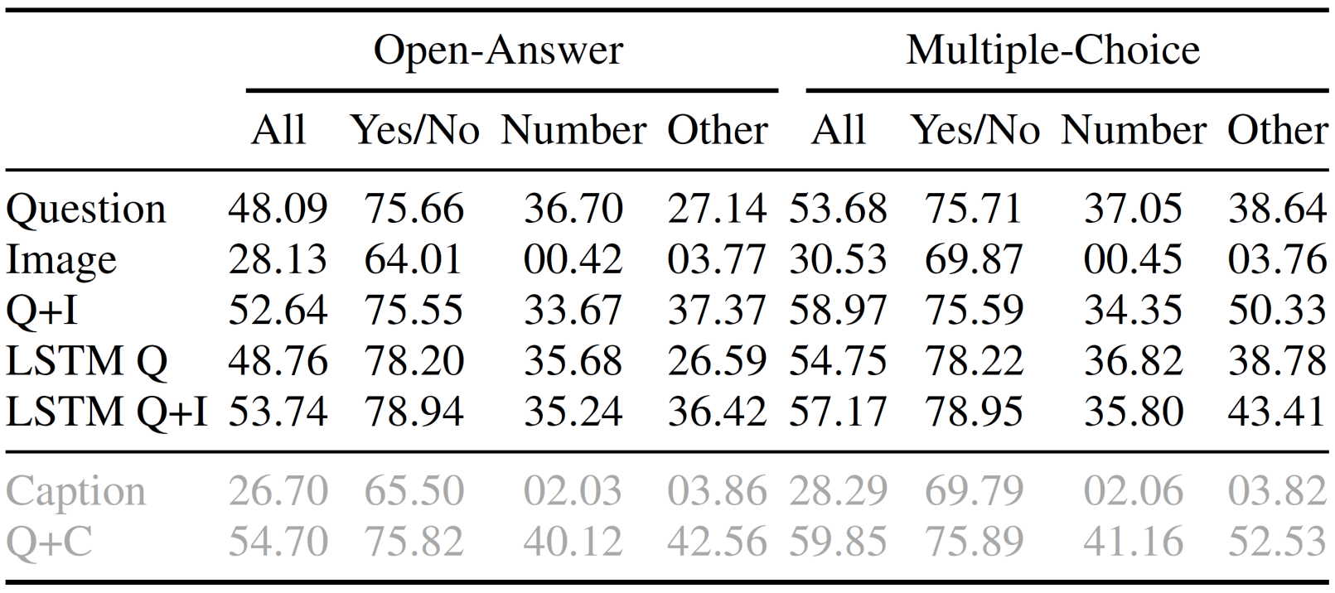
Dayu Wang (45) - VQA Baselines and Methods - Testing
·Testing - “Open-Answer” and “Open-Choice” Tasks
Open-Answer
Answer with highest activation from all possible k answers
Open-Choice
Answer with highest activation from the potential answers
Study from the Results
Type of question matters.
LSTM is better.
Multiple-Choice is better.
All methods are significantly worse than human performance.

Slide 22
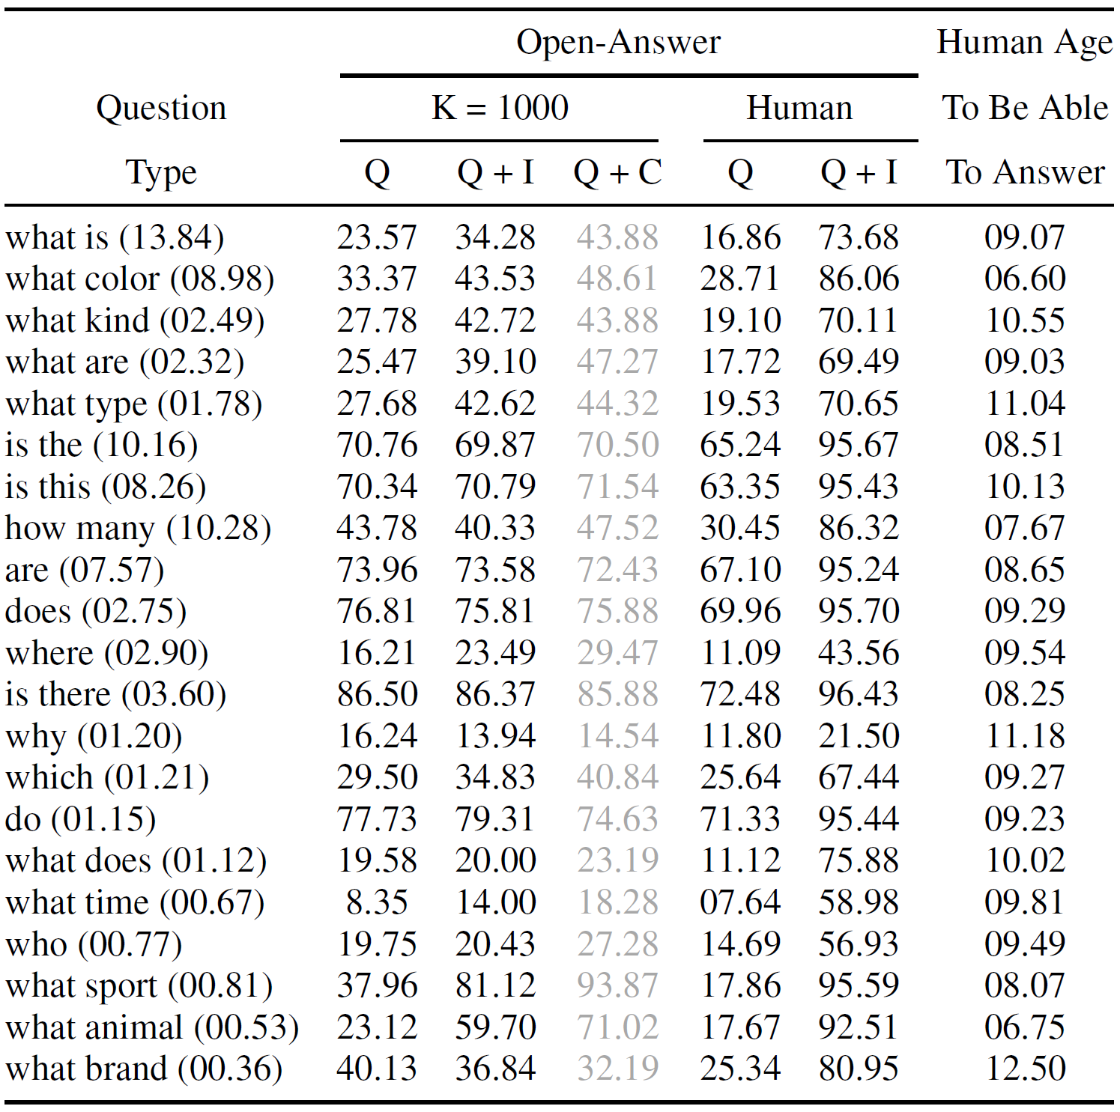
Dayu Wang (45) - VQA Baselines and Methods - Further Insight
·Further Insight
Question Type | Imp?
Requires more reasoning (“How many”, “Is the”) | N
Can be answered using scene-level information (“What sport”) | Y
Answer contained in a generic caption (“What animal”) | Y
For all question types, the results are worse than human accuracies.
Best Model (54.06%): LSTM Q + I
Behaves like a 4.45-year-old child.

Slide 23




Dayu Wang (45) - Conclusion and Discussion
·Conclusion and Discussion (Part 6)
Image
About
NL Answer
NL Question
Eval Server
Dataset | AI Capabilities
250K Images | Computer Vision
760K Questions | Natural Language Processing
10M Answers | Common Sense Reasoning
·The questions were open-ended and not task-specified.
Domain-Specific Data Sets
Enable practical VQA Apps.
Training on task-specific datasets

Slide 24
·This is the END of the presentation.
Mar 21st, 2017
Paper 6 Presentation
“VQA: Visual Question Answering” - Stanislaw Antol, et al.
(Proceedings of the IEEE International Conference on Computer Vision, 2015)
Team 9: Chen Wang (44), Yunlong Liu (22), and Dayu Wang (45)
Questions?
Thank you!

